Slide 1
AddictoMed
Final Presentation Group “Black”
Michael Däppen, Armon Dressler, Moritz Kündig, Samuel Pulfer, Roger Tschanz

Slide 2
Table of Contents
features implemented vs. design thinking ideas
architecture & coding highlights
Patterns
list of personal contributions
lessons learnt
Scrum retrospective

Slide 3
Review Design Thinking Process

Slide 4
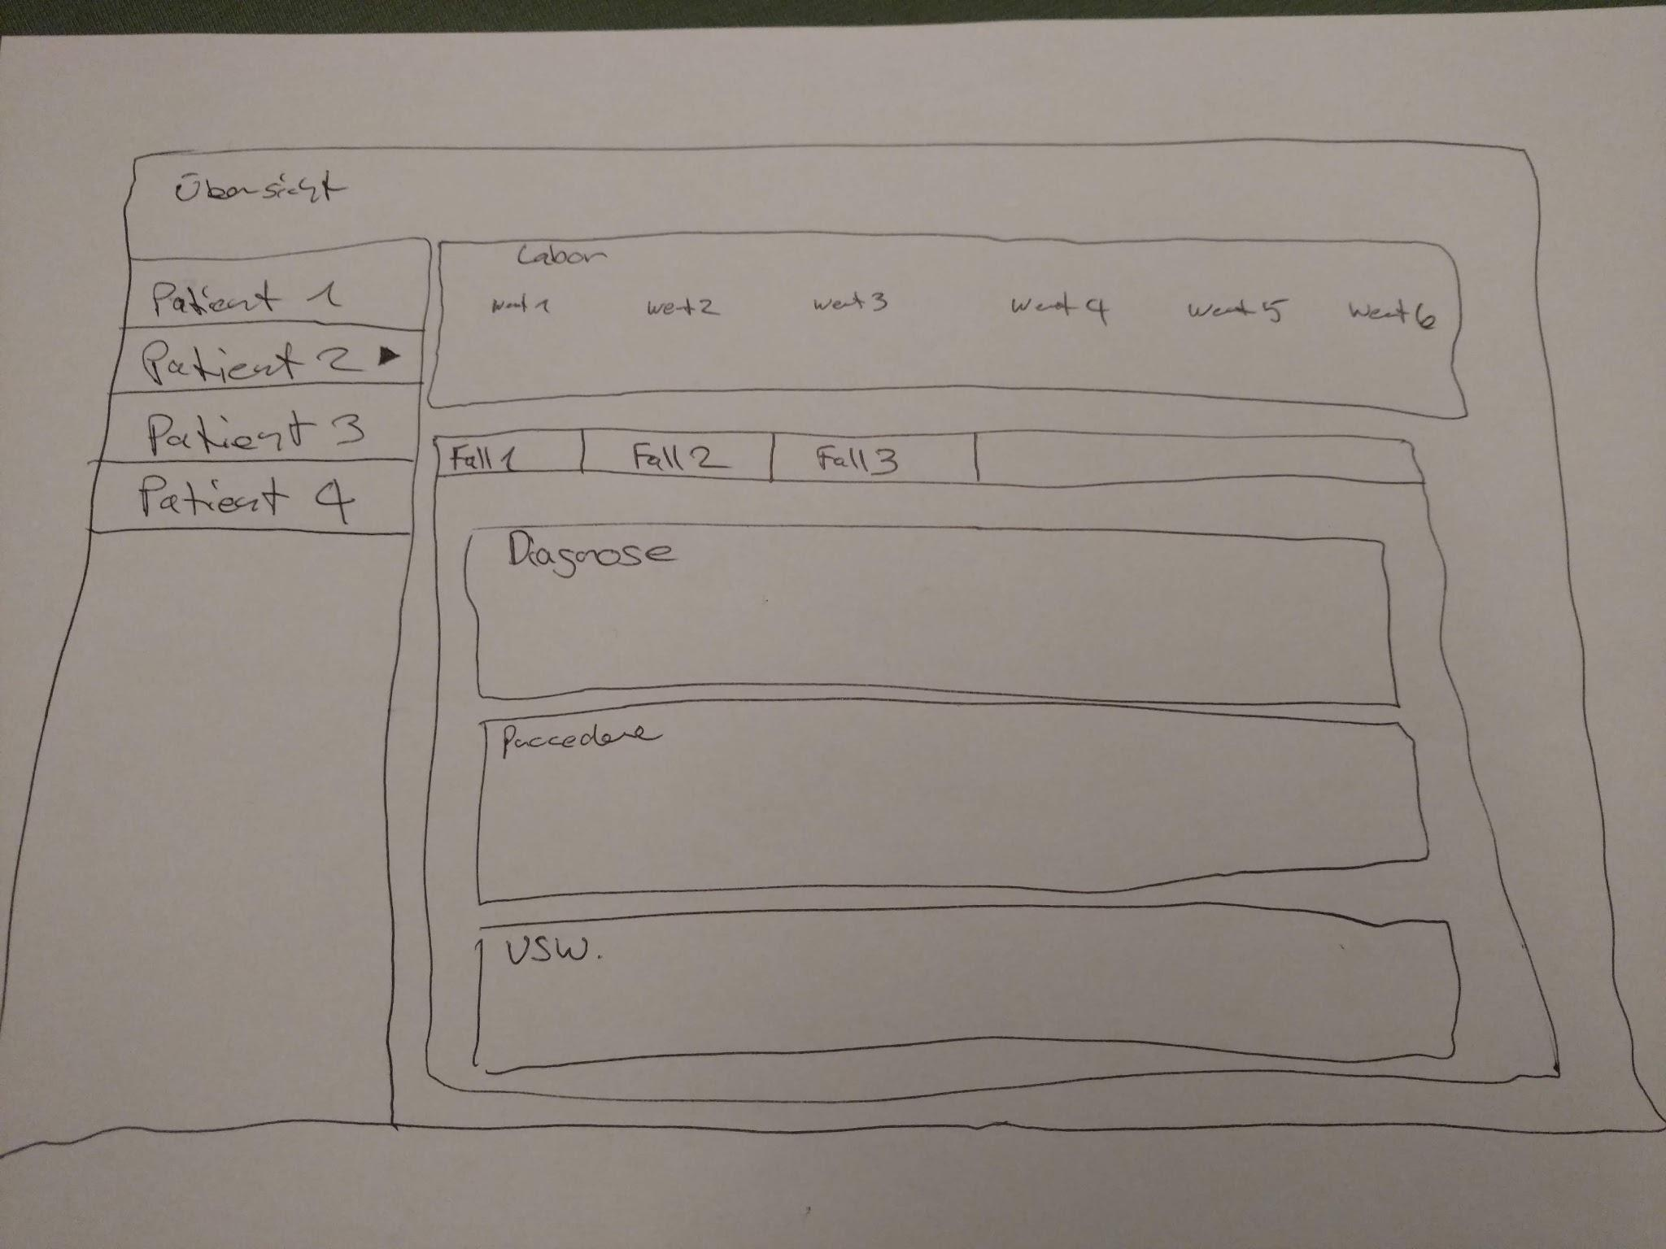
Review Design Thinking Process
Implemented
Overview
Patients
Cases
Diagnosis, Appointments and Anamnesis
Not Implemented
Lab, Lab-Results
Drug, Prescription

Slide 5
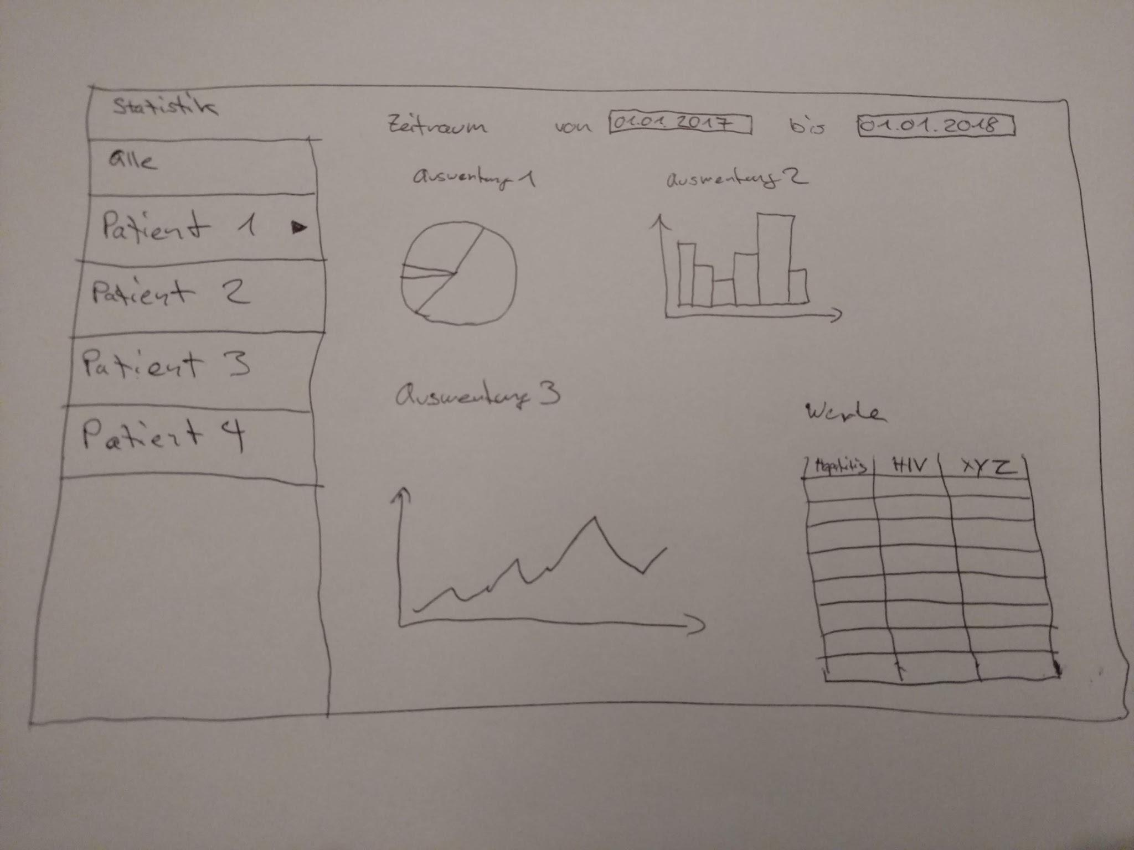
Review Design Thinking Process
Reports
Implemented
CaseReport
DailyReport
WeeklyReport
PatientReport
BusinessReport
Not Implemented
Visual streamlining
Statistics of Reports

Slide 6
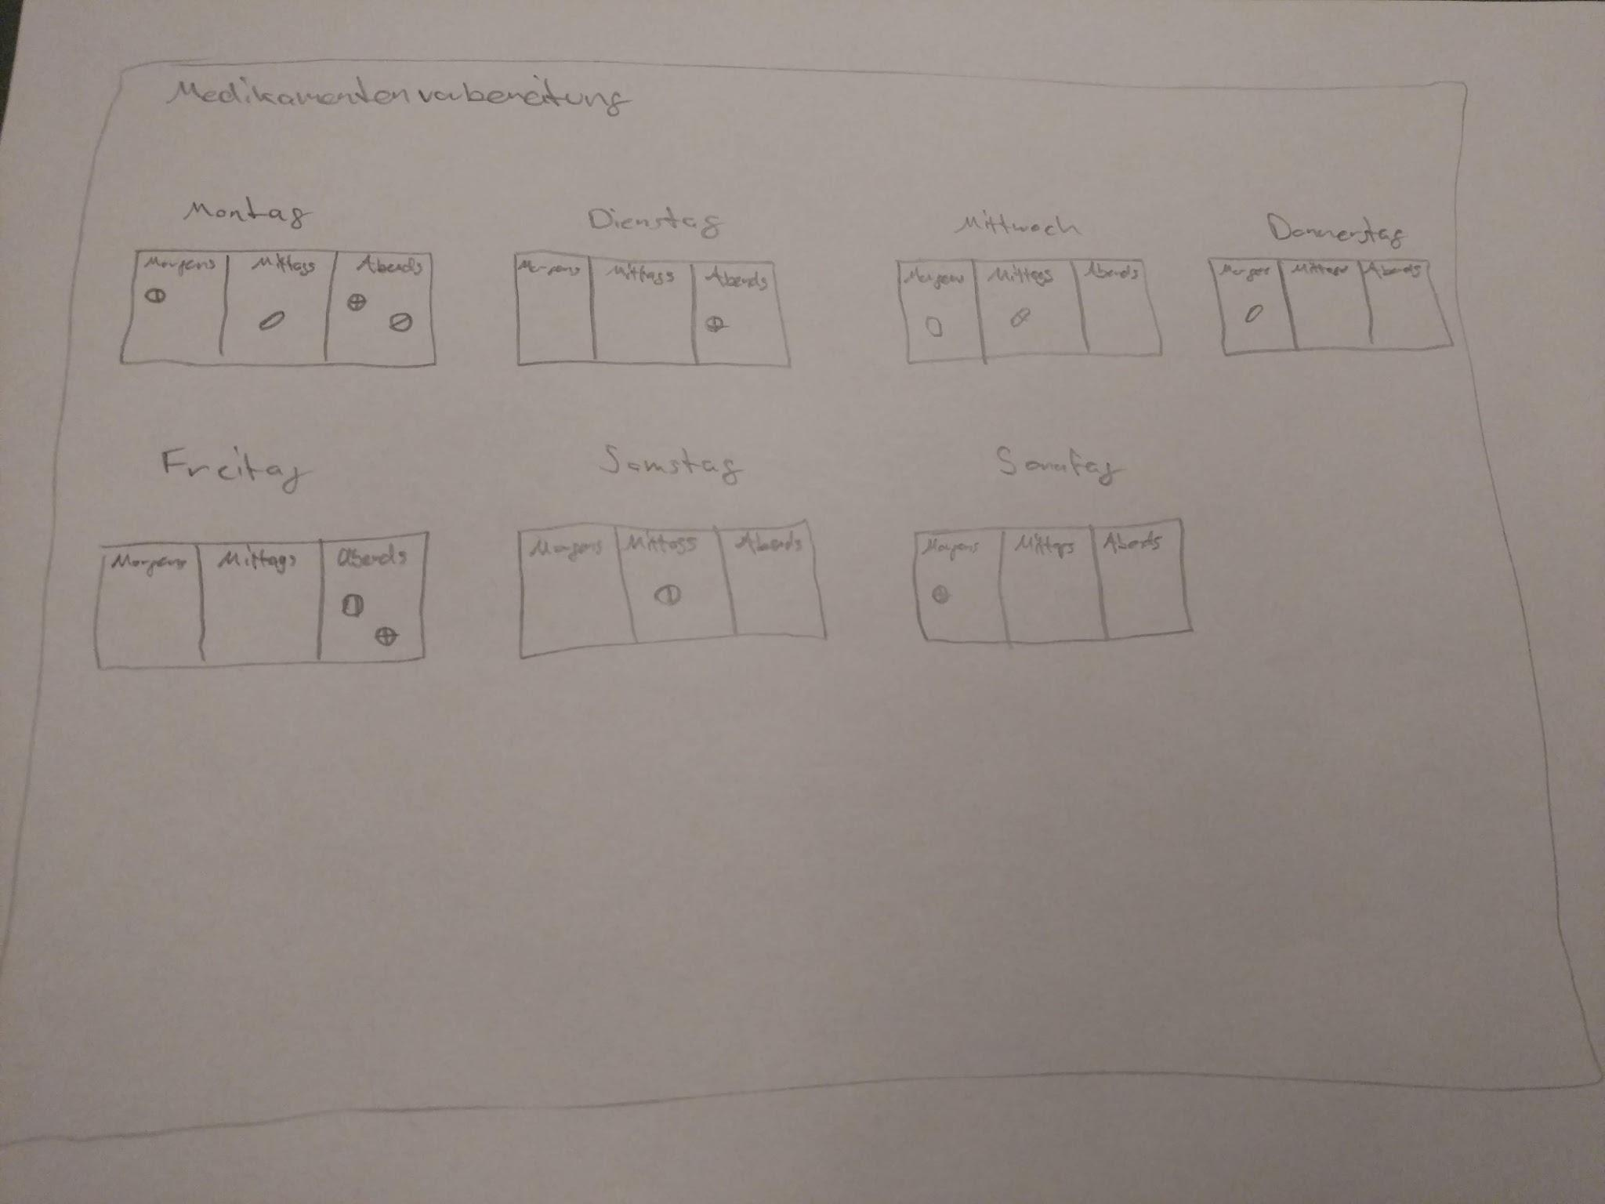
Review Design Thinking Process
Function for “Medical and Drug Evaluation”
Not Implemented.

Slide 7
Coding Highlights

Slide 8
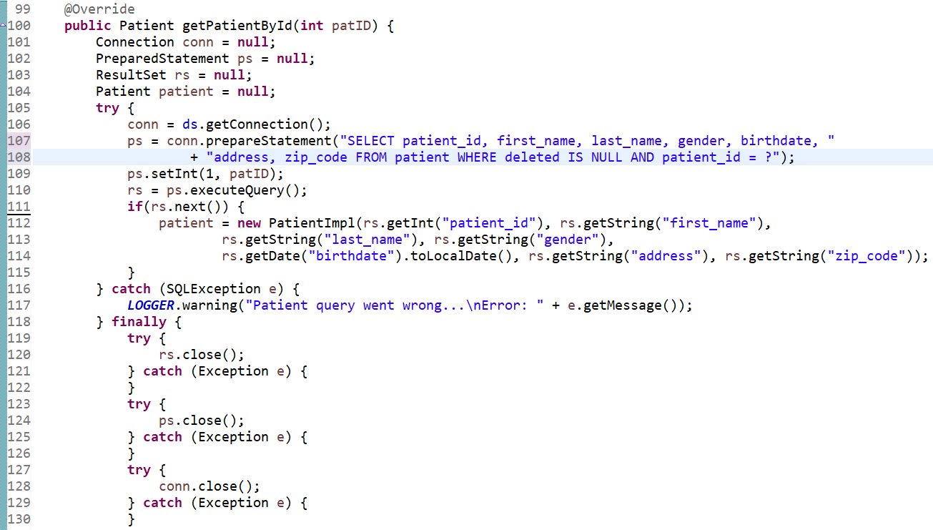
Code-Example: Model PatientModelImpl

Slide 9
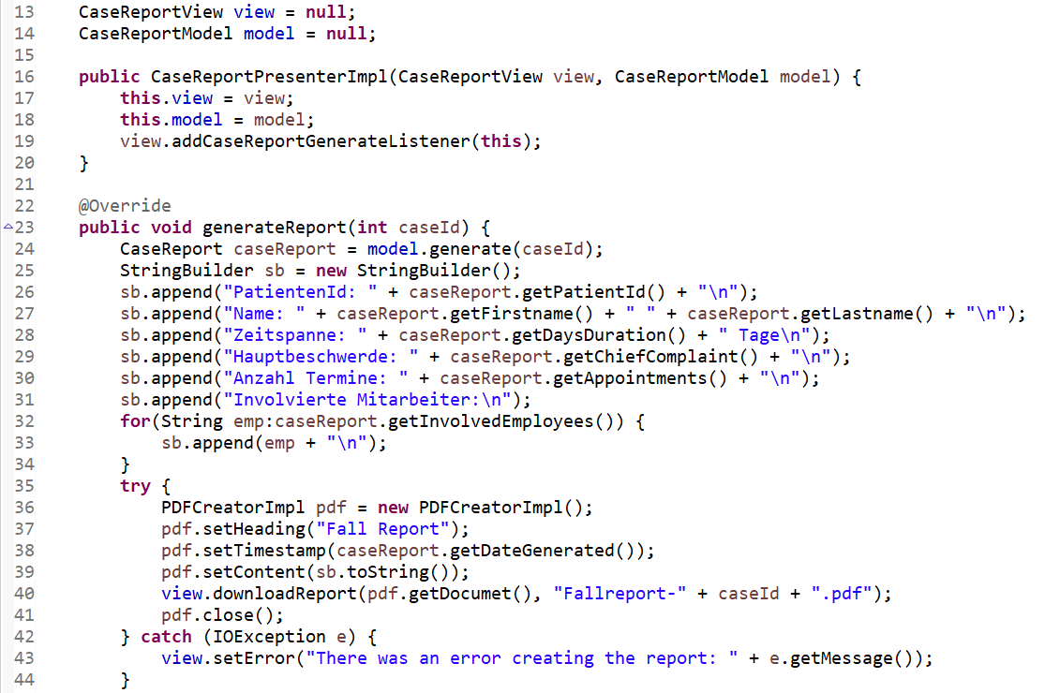
Code-Example: Presenter (CaseReport)

Slide 10
Contributions

Slide 11
Contributions
Michael Däppen
github.com/damichu
Armon Dressler github.com/tetanushamster
Moritz Kündig github.com/kundm2
DB Implementation (SQL)
Case Detail Models (Anamnesis, Insurance)
Patient report
MainCasePresenter
Code Refactoring
LabResults Model
Business report
Class Diagram
ERD
MainPatient View
Daily report

Slide 12

Contributions
Samuel Pulfer github.com/samuelpulfer
Roger Tschanz github.com/tschr3
DB Set-up
Screen Design
Patient Model
Case Report
AppLayout
Code Refactoring
SQL Example-data
Case, Appointment, Lab(result), Prescription Model
Appointment Details
Weekly report

Slide 13
Lessons learnt + Scrum retrospective

Slide 14
Lessons learnt + Scrum retrospective
Ney
Took on too much
Underestimated workload of a “simple” feature (ignoring professor’s warning)
GIT
Partly unmotivating grading 25% vs. workload
Yey
Easy team-dynamics
good communication
Result: working basic-system
First “real” project based -> new experience better than endless school-examples
New experience for unexperienced programmer
Notes:
Zu viel vorgenommen,
Aufwand unterschätzt (Report), Tasks verschoben Sprint,
GIT unerfahren, Einarbeitungszeit
zählt nur 25%
Erstes richtiges Projekt, bisher typische Schulübungen
Interessante Erfahrung

Slide 15
Lessons learnt + Scrum retrospective
Scrum
Not as easy as it sounds
Discipline required for consequent use of daily/weekly scrum (activities)
worked well, but could’ve been done better
Notes:
Workload falsch geplant,
Tasks verschoben
Planung durcheinander

Slide 16
Demo

Slide 17
Quellen
http://clipart-library.com/img/1158226.jpg

